Slide 1



Competitive
Programming
A Sport
for
Enthusiastic
Programmer

Slide 2
LESSON OBJECTIVE
To kick start a journey on competitive programming and start building your programming profile.

Slide 3

LET’S BEGIN

Slide 4
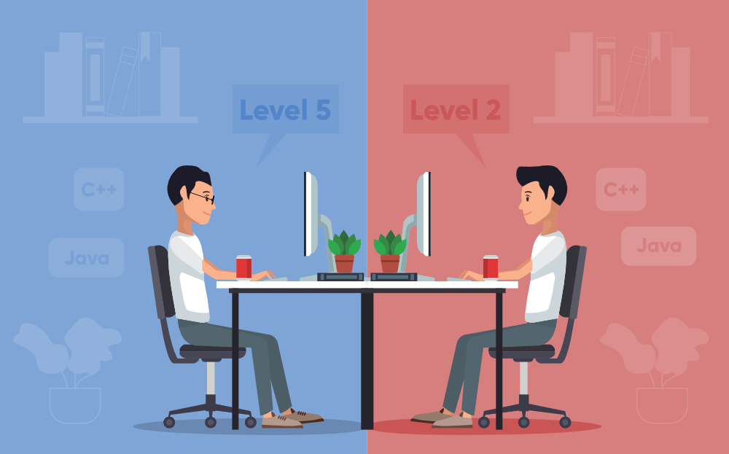
COMPETITIVE PROGRAMMING
Competitive programming is a mind sport usually held over the Internet or a local network, involving participants trying to program according to provided specifications.
Contestants are referred to as sport programmers.
Competitive programming is recognized and supported by several multinational software and Internet companies, such as Google and Facebook.

Slide 5
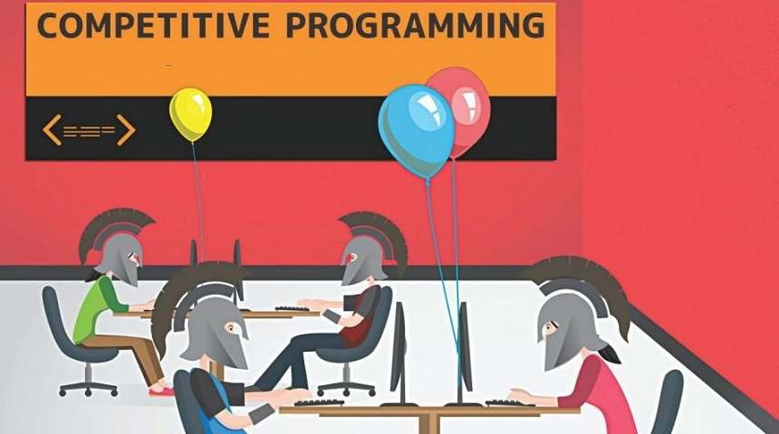
COMPETITIVE PROGRAMMING
There are several organizations who host programming competitions on a regular basis.
A programming competition generally involves the host presenting a set of logical or mathematical problems, also known as puzzles, to the contestants (who can vary in number from tens to several thousands), and contestants are required to write computer programs capable of solving each problem.

Slide 6
NOTABLE COMPETITIONS
There are two types of competition formats: short-term and long-term. Each round of short-term competition lasts from 1 to 5 hours. Long-term competitions can last from a few days to a few months.
SHORT-TERM
International Collegiate Programming Contest (ICPC) – one of the oldest competitions, for students of universities in groups of 3 persons each
International Olympiad in Informatics (IOI) – one of the oldest competitions, for secondary school students
American Computer Science League (ACSL) – computer science competition with written and programming portions, for middle/high school students
CodeChef – competition held from 2009, there are three contests held every month and an annual competition called CodeChef SnackDown

Slide 7
NOTABLE COMPETITIONS
Codeforces Round – typically two hour contest, held every week
Facebook Hacker Cup – competition held from 2011, provided and sponsored by Facebook
HackerRank – multiple competitions
Gridwars – four competitions held between 2003 and 2004.
Google Code Jam – competition held from 2003, provided and sponsored by Google
IEEEXtreme Programming Competition – annual competition for IEEE Student Members held since 2006 by IEEE.
Topcoder Open (TCO) – Algorithm competition held since 2001 by Topcoder

Slide 8
COMPETITIVE PROGRAMMING
In most of the above competitions, since the number of contestants is quite large, competitions are usually organized in several rounds.
They usually require online participation in all rounds except the last, which requires onsite participation.
A special exception to this is IEEEXtreme, which is a yearly 24-hour virtual programming competition.

Slide 9
COMPETITIVE PROGRAMMING
The top performers at IOI and ACM-ICPC receive gold, silver and bronze medals while in the other contests, cash prizes are awarded to the top finishers.
Also hitting the top places in the score tables of such competitions may attract interest of recruiters from software and Internet companies.

Slide 10
NOTABLE COMPETITIONS
Long-term
HackerRank Week of Code
ICFP Programming Contest – annual 3-day competition held since 1998 by the International Conference on Functional Programming
Topcoder Marathon Matches

Slide 11
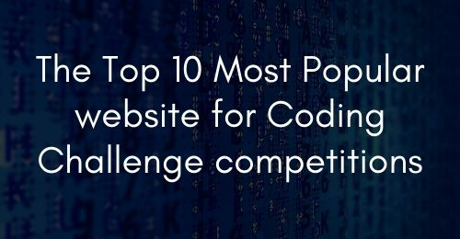

Slide 12
Competitive Platforms
CodeChef 10. SPOJ
CodeCup 11. CoderByte
Codeforces 12. CodeWars
CodinGame 13. LeetCode
HackerEarth
HackerRank
TopCoder
ProjectEuler
AtCoder

Slide 13

BOOKS TO FOLLOW
Introduction to Algorithms
Competitive Programming 3 by Steven Halim
Guide to Competitive Programming by Antti Laaksonen
Programming challenges by Steven S Skiena
The Algorithm Design Manual
Please play this video in lecture: https://youtu.be/fJJoaJ_A-w4

Slide 14
REFERENCES :
Competitive programming – Wikipedia

Slide 15


